Slide 1


My Milk is Better than yours! The Effect of Origin Labelling Regimes on Preferences of Milk Consumers
Authors: Milan Tatic¹, Sanja Dzever², Danilo Djokic², Bojan Matkovski², Monika Hartmann¹
¹ Institute for Food and Resource Economics / University of Bonn, Germany
² Department of Agricultural Economics and Agribusiness / University of Novi Sad, Serbia
27.08.2025

Slide 2
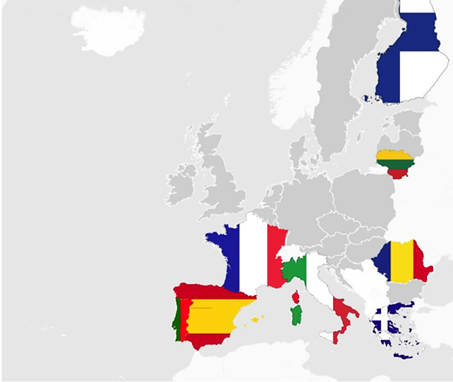
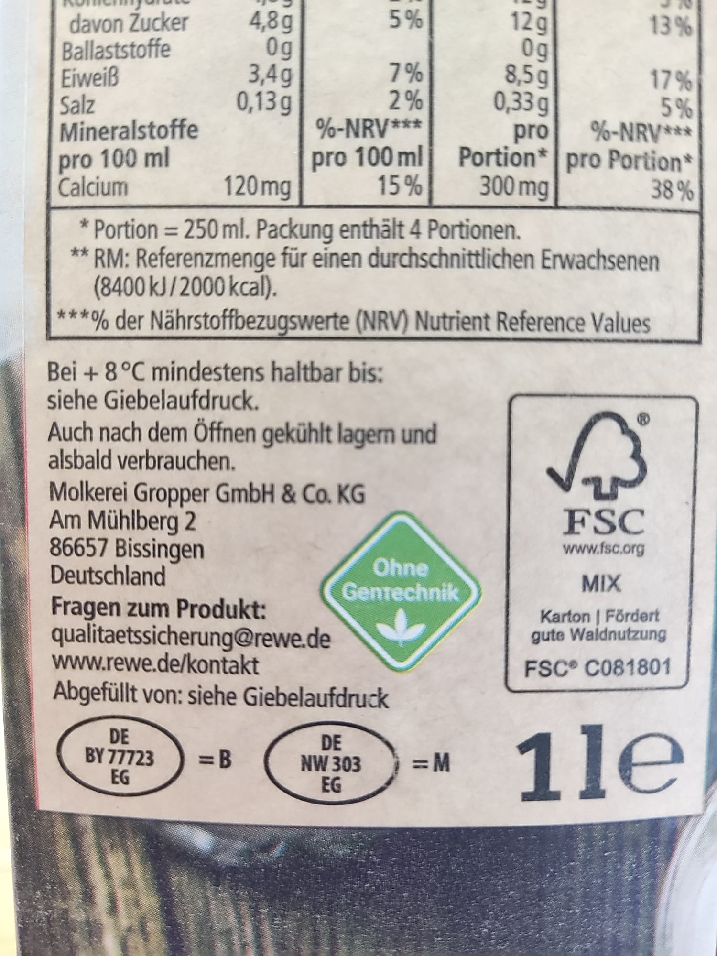
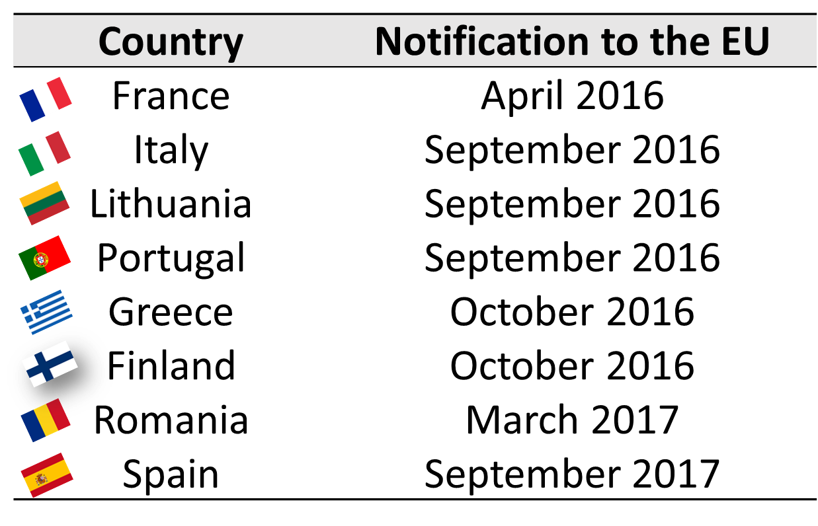


background
Definition: Mandatory Country of Origin Labelling (MCOOL) is a policy that requires the country of origin to be indicated in a specific manner on certain food products.
MCOOL in the EU: In place for a variety of food products (EU 1169/2011 - FIC), not for milk and milk used as an ingredient in dairy products:
Status-quo | National MCOOL^{[1,2]} | General (EU-wide) MCOOL^{[3,4,5]}
The name and the address of the food business operator (FIC) All products of animal origin must bear identification mark (EC 853/2004) A variety of voluntary schemes in the market | Introduced by 8 EU MS in 2016-2017 Requires country of milking and country of processing to be clearly indicated Non-discrimination clause – applicable to national food business operators only | Envisaged by FIC Assessment report for the EC with unfavorable conclusions published in 2014 Expansion of MCOOL outlined in Farm2Fork strategy and recently pushed by Germany- and Austria-led initiative
Notes:
https://www.bmel.de/EN/topics/food-and-nutrition/food-labelling/EU-wide-food-labelling-lmiv-fic.html
https://data.consilium.europa.eu/doc/document/ST-10321-2024-INIT/en/pdf

Slide 3
The current study
Problem:
MCOOL ↔ protectionism^{[6,7,8,9]}
National milk MCOOL measures in the EU not universally well received – fears of supply chain renationalization^{[10,11]}
Lack of studies to inform public policy regarding consumer responses to both national MCOOL measures imposed by some EU MS and potential EU-wide MCOOL
Objective:
To investigate the effect of (1) national MCOOL (nMCOOL) and (2) (hypothetical) general (EU-wide) MCOOL (gMCOOL)on consumer preferences (WTP) for domestic and foreign milk (vs. status quo, control, scenario)

Slide 4
Conceptual model
Drawing on the existing COO body of research ^{[12,13]}:
Hypotheses
nMCOOL:
Milk country of origin labeling system:
Status quo
nMCOOL
gMCOOL
H1a: ↗ WTP for milk sourced and processed domestically.
H1b: ↘ on WTP for milk sourced abroad and processed domestically.
H1c: ↔ effect on WTP for imported milk.
gMCOOL:
WTP_{milk origin from country i}
H2a: ↗ WTP for milk sourced and processed domestically.
H2b: ↘ WTP for milk sourced abroad and processed domestically.
H2c: ↘ WTP for imported milk.

Slide 5
Methodology – study design
Provision of origin information differs
Instrument: Online survey with a DCE on long-life (UHT) milk in a between-subject setup.
Sample: N_{total} = 1302, N_{control} = 441, N_{nmcool} = 430, N_{gmcool} = 431
DCE characteristics:
10 choice tasks per respondent with two alternatives and an opt-out option
D-efficient design generated in Ngene based on the priors from the pilot study (N=110, pooled mixed logit model)
Table 1: Attribute levels used in the DCE
between-subject setup
Origin indication
 | Production method | Origin indication |  |  | Price RSD (EUR)
 |  | Country of milking | Country of processing | Acronym
1 | Conventional | Serbia | Serbia | RSRS | 109.99 (0.94)
2 | Organic | Bosnia & Hercegovina | Serbia | BHRS | 129.99 (1.11)
3 |  | Bosnia & Hercegovina |  | BH | 149.99 (1.28)
4 |  | Croatia |  | HR | 169.99 (1.45)
5 |  | Poland |  | PL | 189.99 (1.62)

Slide 6
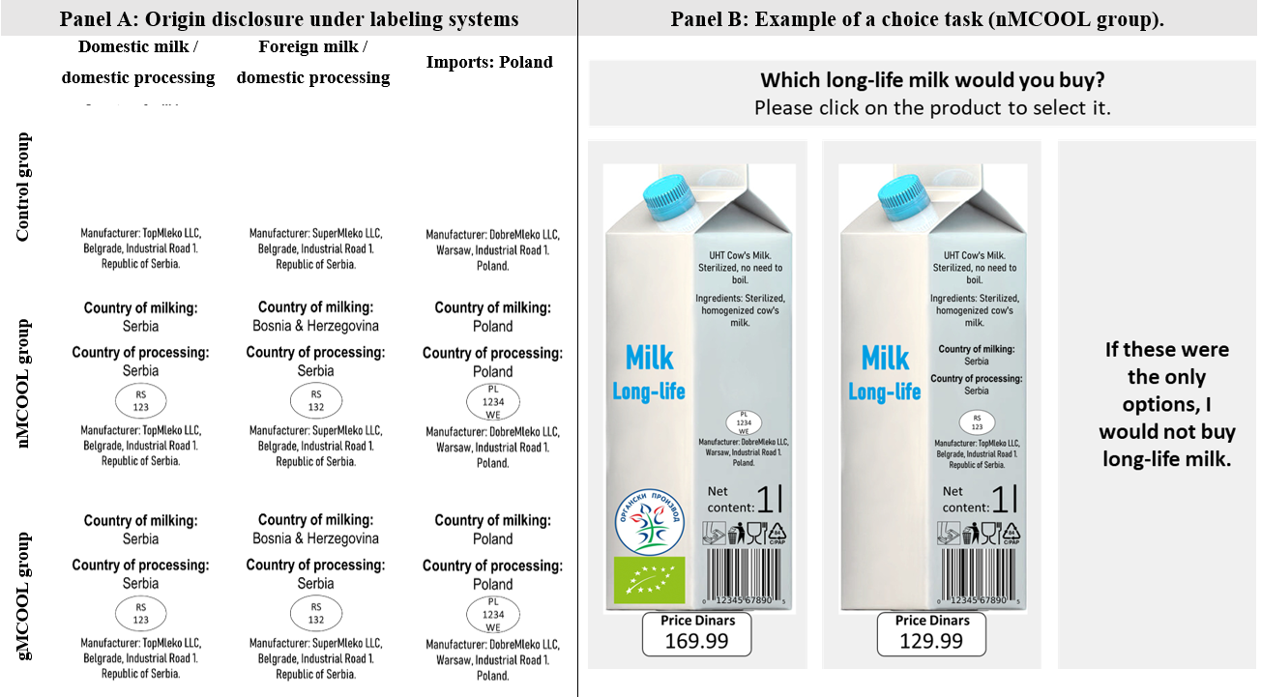
Figure 1: Experimental design: Origin labelling treatments (Panel A) and example of a discrete choice task (Panel B)

Slide 7
Methodology – analytical approach
RPL model for each experimental condition:
250 Halton draws
Organic and origin as random parameters with normal distribution
Correlation between random parameters
Price and opt-out as fixed parameters
1
2
MWTP estimation and comparison using Poe test ^{[14]}:
Krinsky and Robb method with 10,000 replications and confidence level of 95%
Conditional demand curve simulation ^{[15]}:
Based on RPL models estimates (coefficients, st. dev., correlations)
Monte Carlo simulation (25,000 draws) of predicted choice shares at varying focal prices
Own-price demand curves derived as predicted market share at different own price levels assuming price of other alternatives fixed at RSD 129.99
3

Slide 8
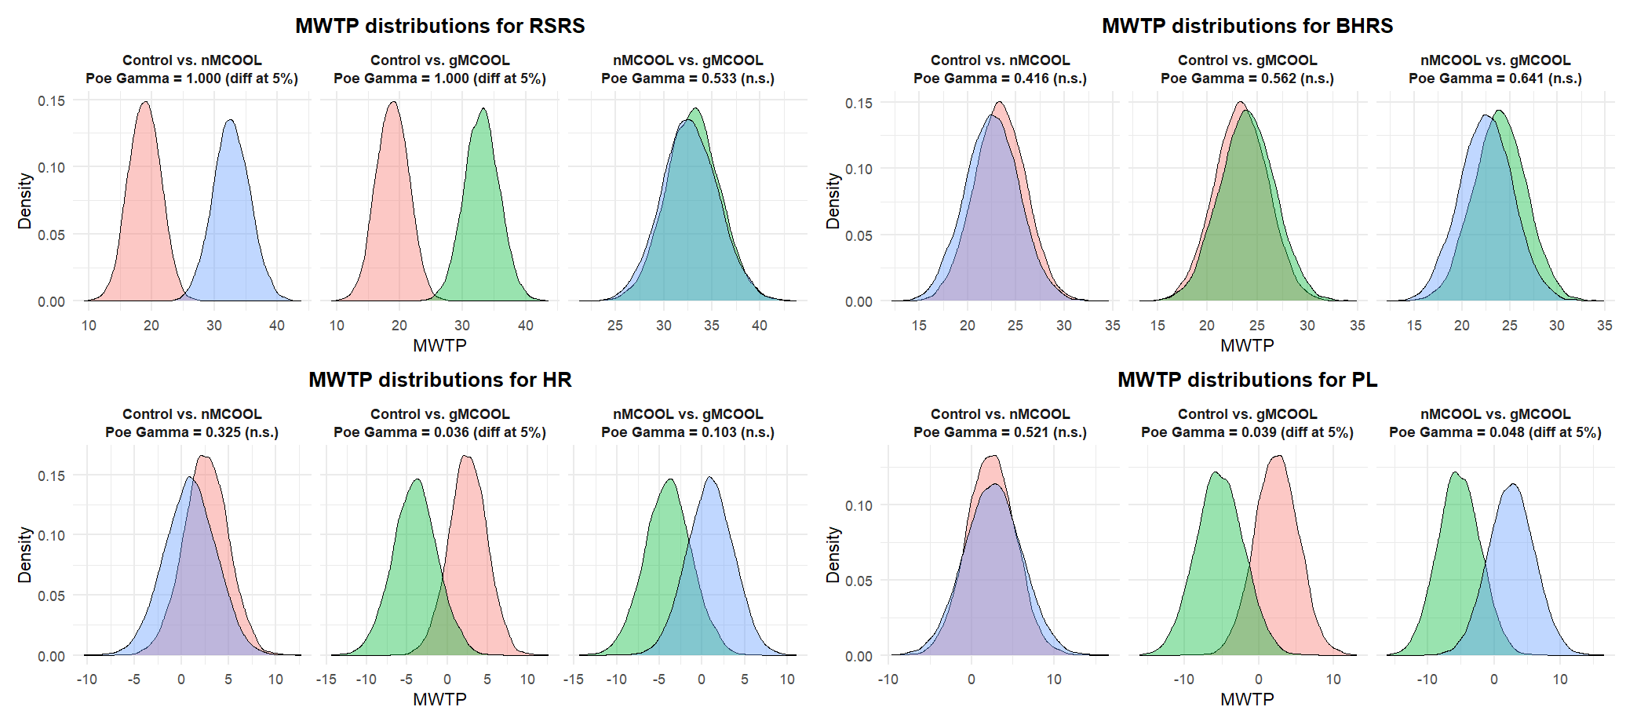
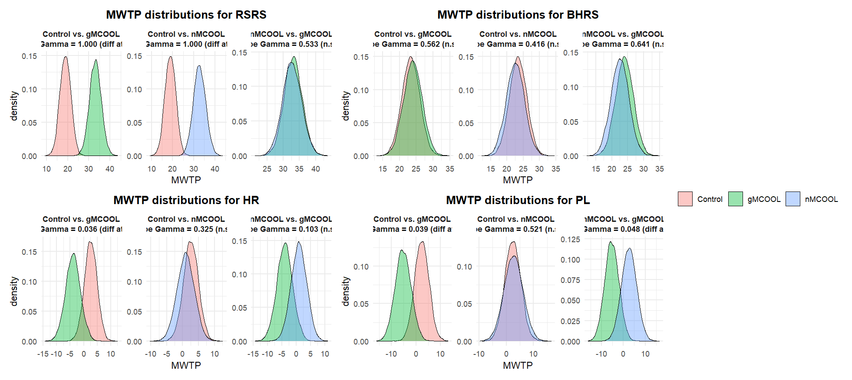
Results: WTP under different milk origin labelling systems
Figure 2: Distributions of mean willingness-to-pay (MWTP) estimates across groups and pairwise comparisons using Poe test.

Slide 9
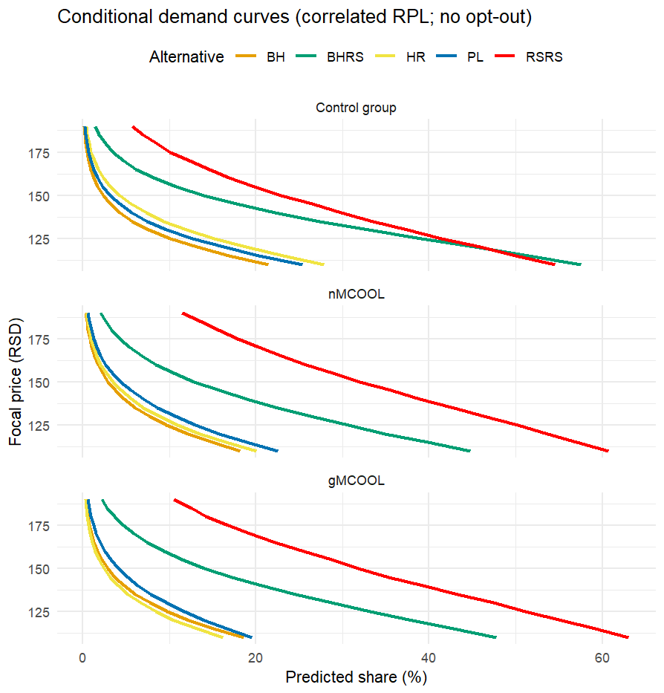


Results: Hypotheses testing results and conditional demand curves
Figure 3: Conditional demand curves
Hypotheses
nMCOOL:
H1a: ↗ WTP for milk sourced and processed domestically
H1b: ↘ on WTP for milk sourced abroad and processed domestically
H1c: ↔ effect on WTP for imported milk
gMCOOL:
H2a: ↗ WTP for milk sourced and processed domestically
H2b: ↘ WTP for milk sourced abroad and processed domestically
H2c: ↘ WTP for imported milk

Slide 10
Discussion
Consumer already (status quo group) show stronger MWTP for domestic milk
In accordance with the COO literature ^{[12,13]}
nMCOOL and gMCOOL increase MWTP for domestically produced and sourced milk
A potential advantage for domestic sourcing/producing
No sig. dif. in MWTP for “mixed” origin (Bosnian milk processed in Serbia), but:
Domestic sourcing attracts higher WTP premium → demand curves show drop in market share for “mixed” origin
Not an extensive coverage of potential combinations
Significant drop in MWTP under gMCOOL condition for imported milks (HR and PL)
Origin info more accessible → easier for consumers to discriminate

Slide 11
conclusions
nMCOOL
gMCOOL
MWTPs show advantage for domestic sourcing/processing and no sig. dif. for mixed origin and imports
MWTPs show advantage for domestic sourcing/processing, disadvantage for imports and no sig. dif. for “mixed” origin
Conditional simulated demand curve show:
↗ market share for domestic
↘ market share for “mixed”/imports
“Assessment for EU-wide meat MCOOL shows “marginal effects on market and trade dynamics, with the cost of adaptation absorbed in the supply chain and not transferred to consumers” ^{[16]}
To assess potential effects of EU-wide milk MCOOL: input from policy makers + further research, while also considering the presence of voluntary origin labelling

Slide 12

Thank you for your attention!
Contact: Milan Tatic
milan.tatic@ilr.uni-bonn.de
Funding:

Slide 13
References
Carreño, I., & Dolle, T. (2017). A Myriad of EU Member States’ Measures on Mandatory Country of Origin Labelling (COOL) of Food Compromise the EU Internal Market. European Journal of Risk Regulation, 8(4), 779-786.
Laaninen, T. (2018). Briefing: Mandatory origin-labelling schemes in Member States. https://www.europarl.europa.eu/RegData/etudes/BRIE/2018/625182/EPRS_BRI(2018)625182_EN.pdf.
Baltussen, W. H. M., Beekman, V., de Graaff, R. P. M., Borgstein, M. H., Blokland, P. W., Helming, J. F. M., ... & van Haaster-de Winter, M. A. (2014). Study on mandatory origin labelling for milk, milk used as an ingredient in dairy products, and unprocessed meat other than beef, pig, poultry, and sheep and goat meat AGRI-2013-EVAL-03 Study Report: Part A–Milk and milk used as an ingredient in dairy products. European Commission (EC). https://research.wur.nl/en/publications/study-on-mandatory-origin-labelling-for-milk-milk-used-as-an-ingr-2
Council of the European Union (2024): Country of Origin Labelling for Foodstuffs - Information from the German and Austrian delegations, supported by the Estonian, Finnish, French, and Portuguese delegations, Document 10321/24, Brussels.
EC (2020). Farm to fork strategy. For a fair, healthy and environmentally-friendly food system. https://food.ec.europa.eu/document/download/472acca8-7f7b-4171-98b0-ed76720d68d3_en?filename=f2f_action-plan_2020_strategy-info_en.pdf.
EDA (2023). EDA position paper: Against mandatory origin labelling for milk. https://eda.euromilk.org/fileadmin/user_upload/Public_Documents/EDA_Position_papers_-_Fact_Sheets/Position_papers/2023_03_21_EDA_position_against_mOL_rev.pdf
Greene, J. L. (2015). Country-of-origin labeling for foods and the WTO trade dispute on meat labeling. Washington, DC: Congressional Research Service.
Gremillion, T. (2016). The High Price of Free Trade: Country-of-Origin Labeling and the World Trade Organization. Loy. Consumer L. Rev., 29, p.252.

Slide 14
References
Jacobs, D. (2018). Country of origin labelling: Perspectives and experiences from the European food and drink manufacturing sector. Food Drink Europe. https://www.europarl.europa.eu/cmsdata/148123/Jacobs-presentation.pdf.
Twine, E. E., Rude, J., & Unterschultz, J. (2016). Country of origin labeling and structural change in US imports of Canadian cattle and beef. Canadian Journal of Agricultural Economics/Revue canadienne d'agroeconomie, 64(3), 545-563.
Pouliot, S. and Sumner, D. A. (2014). Differential impacts of country of origin labelling: COOL econometric evidence from cattle markets. Food Policy, 49, 107-116.
Newman, C. L., Turri, A. M., Howlett, E., & Stokes, A. (2014). Twenty years of country-of-origin food labelling research: a review of the literature and implications for food marketing systems. Journal of Macromarketing, 34(4), 505-519.
Thøgersen, J. (2023). How does origin labelling on food packaging influence consumer product evaluation and choices? A systematic literature review. Food Policy, 119, 102503.
Poe, G. L., Giraud, K. L., & Loomis, J. B. (2005). Computational methods for measuring the difference of empirical distributions. American Journal of Agricultural Economics, 87(2), 353-365.
Lusk, J. L., & Tonsor, G. T. (2016). How meat demand elasticities vary with price, income, and product category. Applied Economic Perspectives and Policy, 38(4), 673-711. https://doi.org/10.1093/aepp/ppv050
European Commission. (2021). Evaluation of the mandatory indication of the country of origin or place of provenance for fresh, chilled and frozen meat of swine, sheep, goats, and poultry. SWD(2021) 218 final. https://agriculture.ec.europa.eu/news/origin-labelling-rules-meats-remains-relevant-consumers-2021-08-10_en

Slide 15
Appendix I: Sample characteristics
 |  | Total sample N=1302 | Control N=441 | National MCOOL N=430 | General MCOOL N=431
Age
 | Mean (SD) | 42.42 (10.96) | 43.05 (10.8) | 42.29 (11.27) | 41.89 (10.81)
Gender
 | Female | 60.8% | 63.9% | 60.0% | 58.5%
 | Male | 39.1% | 36.1% | 40.0% | 41.3%
 | Other | 0.1% | 0.0% | 0.0% | 0.2%
Education
 | Primary education | 0.9% | 1.1% | 0.9% | 0.7%
 | Secondary education | 40.2% | 38.8% | 44.0% | 38.1%
 | Vocational education | 17.1% | 18.1% | 14.4% | 18.6%
 | Bachelor | 25.5% | 26.5% | 24.9% | 25.1%
 | Master or higher | 16.3% | 15.4% | 15.8% | 17.6%
Place of residence
 | Village or small city (less than 10,000 inhabitants) | 12.8% | 12.7% | 12.8% | 13.0%
 | Mid-sized city (between 10,000 and 100,000 inhabitants) | 38.5% | 37.4% | 38.8% | 39.2%
 | Large city (more than 100,000 inhabitants) | 48.7% | 49.9% | 48.4% | 47.8%
Household income
 | Regular difficulties in covering all monthly expenses | 7.5% | 8.8% | 6.5% | 7.2%
 | Occasional difficulties in covering all monthly expenses | 9.2% | 10.4% | 10.0% | 7.2%
 | Living paycheck to paycheck | 43.2% | 43.3% | 38.6% | 47.8%
 | Covering all monthly expenses and little savings possible | 35.1% | 32.9% | 40.9% | 31.6%
 | Income allows regular savings | 4.9% | 4.5% | 4.0% | 6.3%

Slide 16
Appendix I: results of RPL models
 | Control group |  | nMCOOL |  | gMCOOL
 | b (SE) | z / p | b (SE) | z / p | b (SE) | z / p
Parameter estimates
Price | –0.06 (0.00) | –31.11 *** | –0.05 (0.00) | –29.62 *** | –0.05 (0.00) | –28.84 ***
None | –9.62 (0.32) | –30.45 *** | –8.12 (0.28) | –29.21 *** | –8.45 (0.29) | –28.85 ***
Organic | 1.39 (0.15) | 9.19 *** | 0.77 (0.12) | 6.27 *** | 0.99 (0.14) | 7.18 ***
RSRS | 1.18 (0.16) | 7.24 *** | 1.72 (0.16) | 11.03 *** | 1.77 (0.15) | 11.57 ***
BHRS | 1.46 (0.17) | 8.75 *** | 1.18 (0.15) | 7.93 *** | 1.28 (0.15) | 8.48 ***
HR | 0.16 (0.15) | 1.09 n.s. | 0.05 (0.14) | 0.35 n.s. | –0.21 (0.15) | –1.46 n.s.
PL | 0.15 (0.18) | 0.81 n.s. | 0.14 (0.18) | 0.75 n.s. | –0.29 (0.17) | –1.65 †
Standard deviation of random coefficients
Organic | 2.64 (0.15) | 17.43 *** | 1.97 (0.12) | 15.84 *** | 2.41 (0.14) | 16.79 ***
RSRS | 0.72 (0.18) | 4.01 *** | 0.72 (0.15) | 4.87 *** | 0.56 (0.16) | 3.45 ***
BHRS | 0.76 (0.18) | 4.31 *** | 0.75 (0.14) | 5.52 *** | 0.83 (0.16) | 5.27 ***
HR | 0.11 (0.18) | 0.63 n.s. | 0.01 (0.18) | 0.06 n.s. | 0.31 (0.18) | 1.69 †
PL | 0.08 (0.23) | 0.34 n.s. | –0.10 (0.22) | –0.44 n.s. | 0.12 (0.21) | 0.54 n.s.
Note: † p < .10, * p < .05, ** p < .01, *** p < .001.

