Slide 1
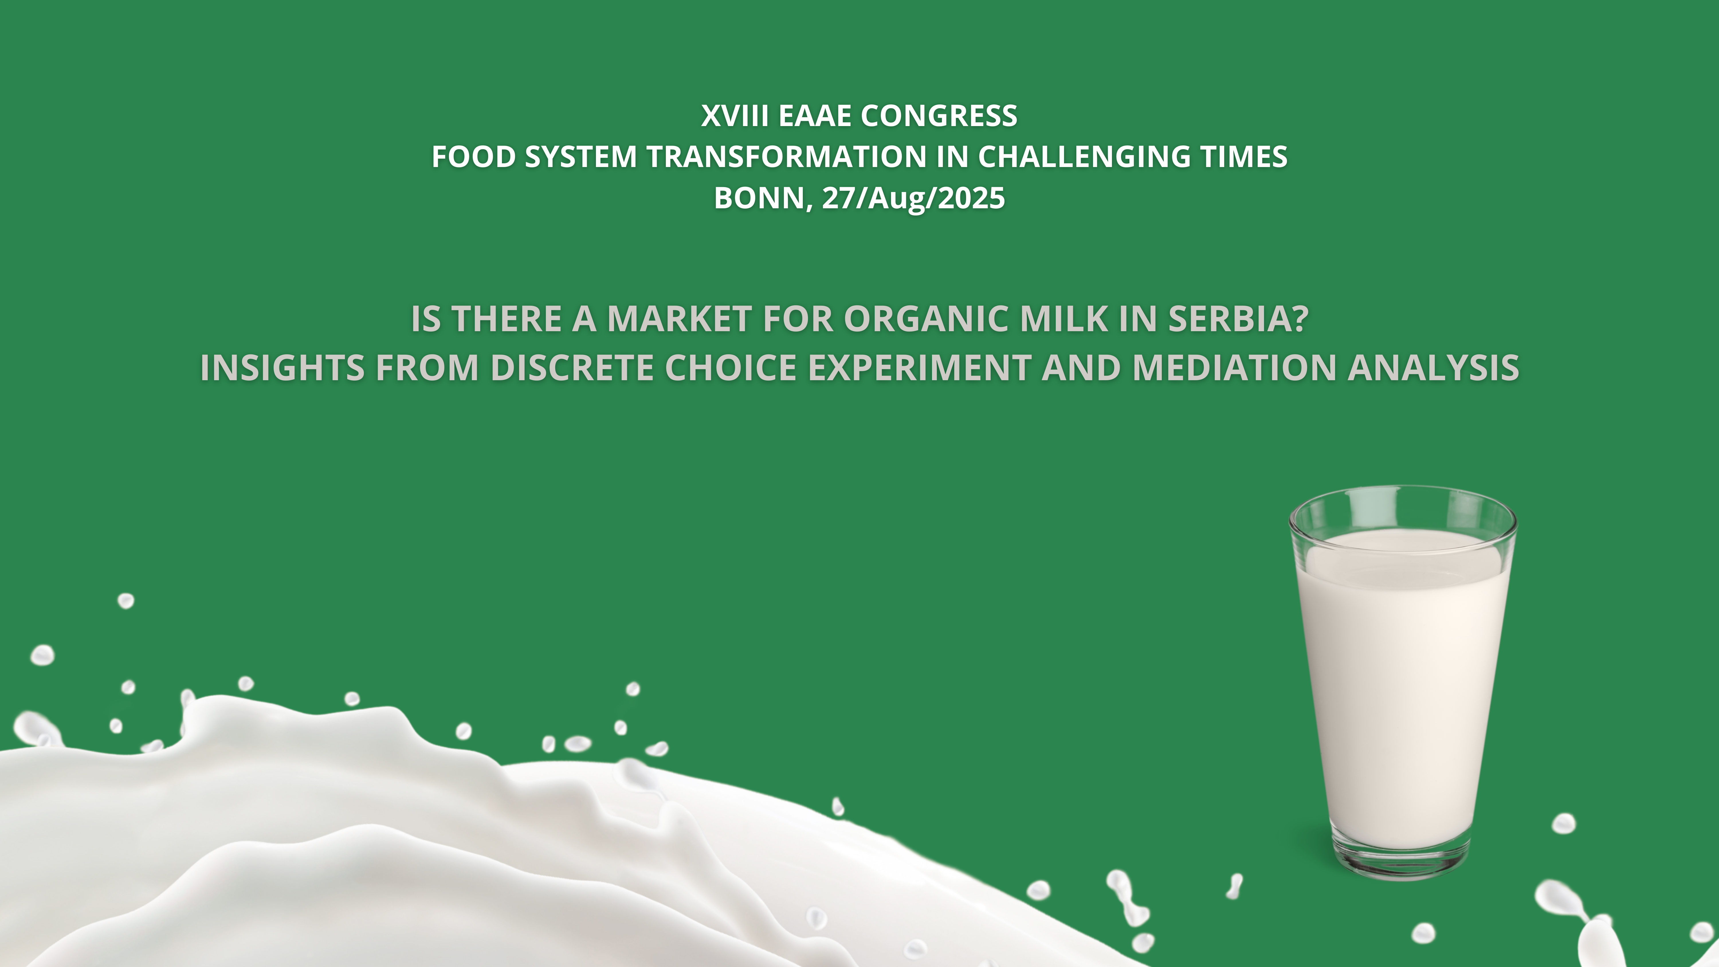
Milan Tatić ¹, Sanja Džever ², Bojan Matkovski ², Žana Jurjević ², Danilo Đokić ²
¹ University of Bonn, Institute for Food and Resource Economics
² University of Novi Sad, Faculty of Economics in Subotica

Slide 2

1
1. INTRODUCTION
ORGANIC FOOD CONSUMPTION - ↗ - developed countries.
MOTIVES - perceived health benefits, environmental sustainability, perceived food safety + better animal welfare.
The literature review - health ¹ concern is the main driver of organic preferences / focus.
SERBIAN ORGANIC MARKET - still in its infancy - preferences are not well understood.
A better understanding = assessing the market potential + identifying opportunities for its expansion.

Slide 3
2
2
1. INTRODUCTION
SIGNIFICANT BARRIER:
High retail price of organic milk, limited offer!
Assessing consumers' WTP - IDENTIFYING PRICE POINTS = encouraging broader adoption of organic milk.
Understanding what drives WTP premiums at the individual level = marketing strategies for organic milk.
OBJECTIVE:
Serbian consumers' WTP for organic milk + the attitudinal and socio-demographic factors that influence WTP premium.

Slide 4
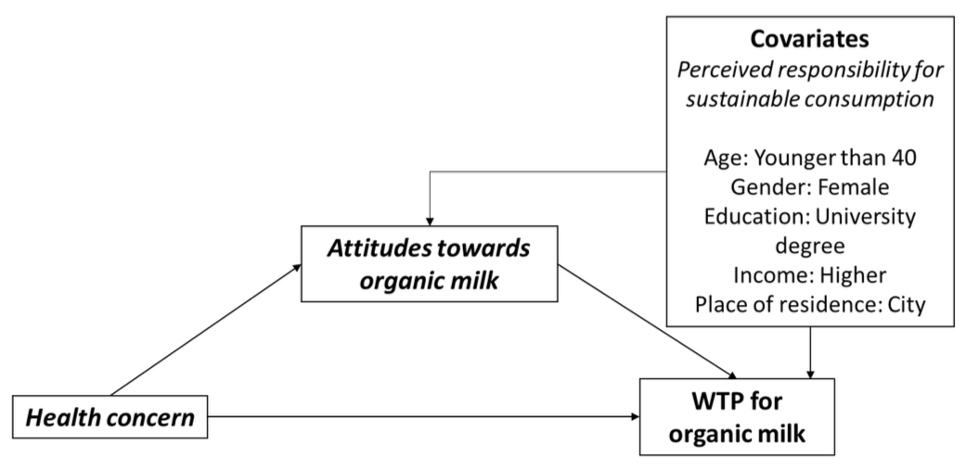
3
2. RESEARCH FRAMEWORK
MEDIATION
Health consciousness has a positive effect on attitudes toward organic milk.
Attitudes toward organic milk have a positive effect on willingness to pay for organic milk.
The effect of health consciousness on willingness to pay for organic milk is partially mediated by attitudes toward organic milk.
H1a Serbian consumers have a positive WTP for organic milk.
H1b There is a significant heterogeneity among Serbian consumers in their WTP for organic milk.
DCE (RPL) MODEL

Slide 5
4
THE 1st
ELIGIBILITY CRITERIA
THE 2nd
MILK PURCHASING HABITS
THE 3rd
THE DCE
THE 4th
THE 5th
3. SURVEY STRUCTURE
The data was collected in Serbia in September 2024 - an online survey distributed by a professional market research agency (N=441)
OMA, PRSC,
HC
THE S-D
DATA
DCE using random parameter logit (RPL) model to account for preference heterogeneity + mediation model (with individual-specific WTP for organic as dependent variable in the mediation).

Slide 6
5
4. DCE DESIGN
The DCE attributes - organic label, origin, and price.
10 choice tasks - two product alternatives & an opt-out option.
The position of the product alternatives within each choice task and the order of the choice tasks were randomized.
Table 1: Attributes and levels of milk used in the choice experiment
Levels | Attributes
 | Type | Origin indication | Price: RSD (EUR)
1 | Conventional | Serbia (manufacturer 1) | 109.99 (0.94)
2 | Organic | Serbia (manufacturer 2) | 129.99 (1.11)
3 |  | Bosnia & Hercegovina | 149.99 (1.28)
4 |  | Croatia | 169.99 (1.45)
5 |  | Poland | 189.99 (1.62)

Slide 7
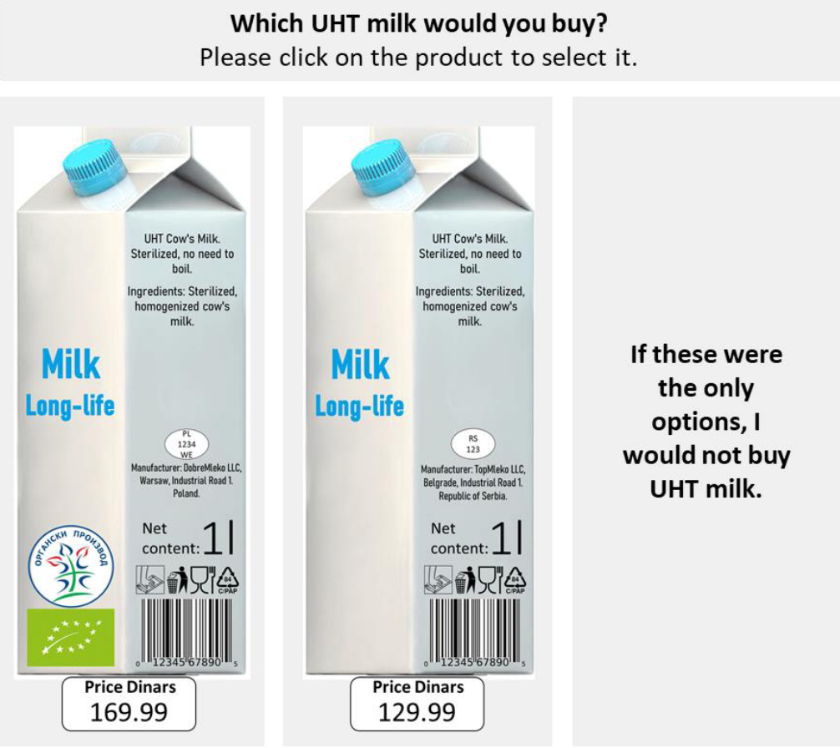
Figure 1: Example of a choice task.
6

Slide 8
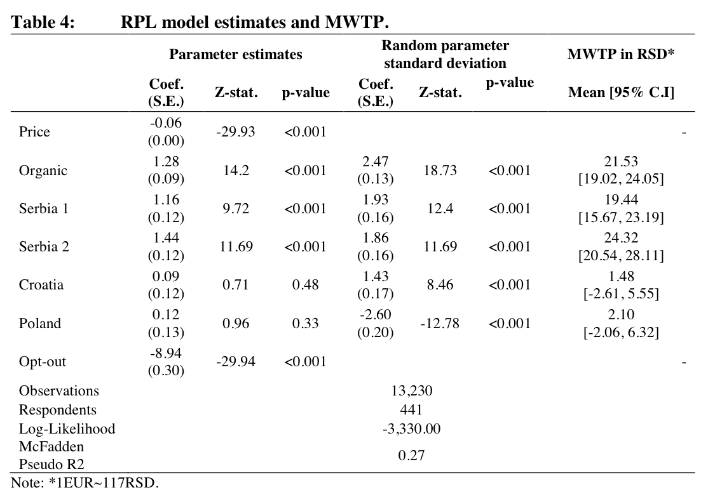
7
5. RESULTS
Table 2: RPL model estimates and MWTP
H1a (accepted) - the median WTP for organic milk of 21.53 RSD indicates that consumers are willing to pay a premium for organic milk.
H1b (accepted) - the significant standard deviation of the organic random parameter suggests substantial heterogeneity in preferences.

Slide 9
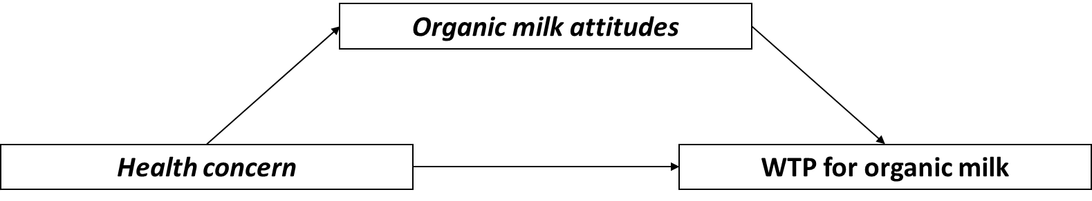
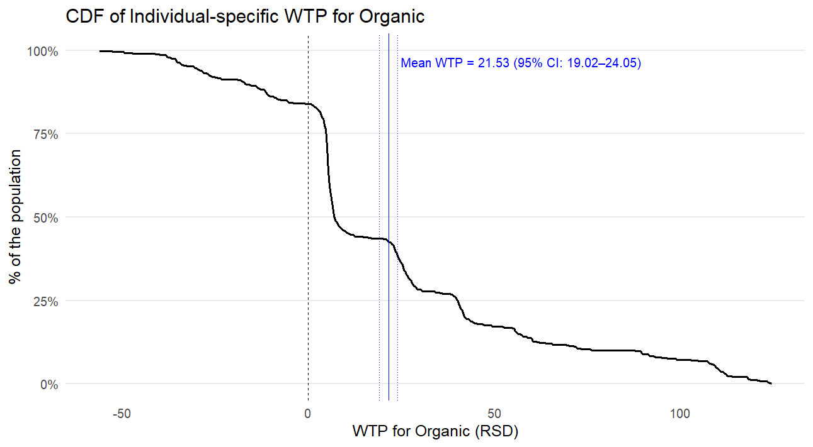
8
5. RESULTS
b (S.E.) = 0.37 (0.06)
95% CI = [0.24, 0.49]
β = 0.28
b (S.E.) = 11.86 (2.28)
95% CI = [7.38, 16.34]
β =0.26
Figure 2: Cumulative density function of individual specific WTP for organic & mean WTP for organic milk
b (S.E.) = -1.08 (3.11)
95% CI = [-7.19, 5.02]
β = -0.02
H2a (accepted) - a significant indirect effect was observed, confirming that an increase in HC leads to a more positive OMA.
H2b (accepted) - OMA has a significant and positive effect on WTP.
H2c (partially rejected) - the direct effect of HC on WTP was not significant, suggesting that HC alone does not determine WTP, but its influence is fully mediated by OMA.
-------------------------------------------------

Slide 10
9
6. DISCUSSION AND CONCLUSION
Positive median WTP, with significant heterogeneity!
High price sensitivity = limiting market expansion at current price levels!
Reducing the price below current levels = increasing market share.
If it remains a premium-priced product / further expansion cannot realistically be expected.
STRENGTHENING CONSUMER CONFIDENCE IN ORGANIC CERTIFICATION
IMPROVING MARKET ORGANIZATION THROUGH COOPERATIVES
ALIGNING MARKETING STRATEGIES WITH HEALTH CONCERNS

Slide 11
10
6. DISCUSSION AND CONCLUSION
OMA was not particularly favorable - low awareness and trust in certification
= weaker attitudes toward organic products.
EDUCATING CONSUMERS ABOUT THE BENEFITS OF ORGANIC PRODUCTION
STRENGTHENING TRUST IN CERTIFICATION
Future research:
  Could enhance realism - in virtual or online supermarkets or employing incentive-compatible DCEs.
  + EYE-TRACKING TECHNOLOGY

Slide 12
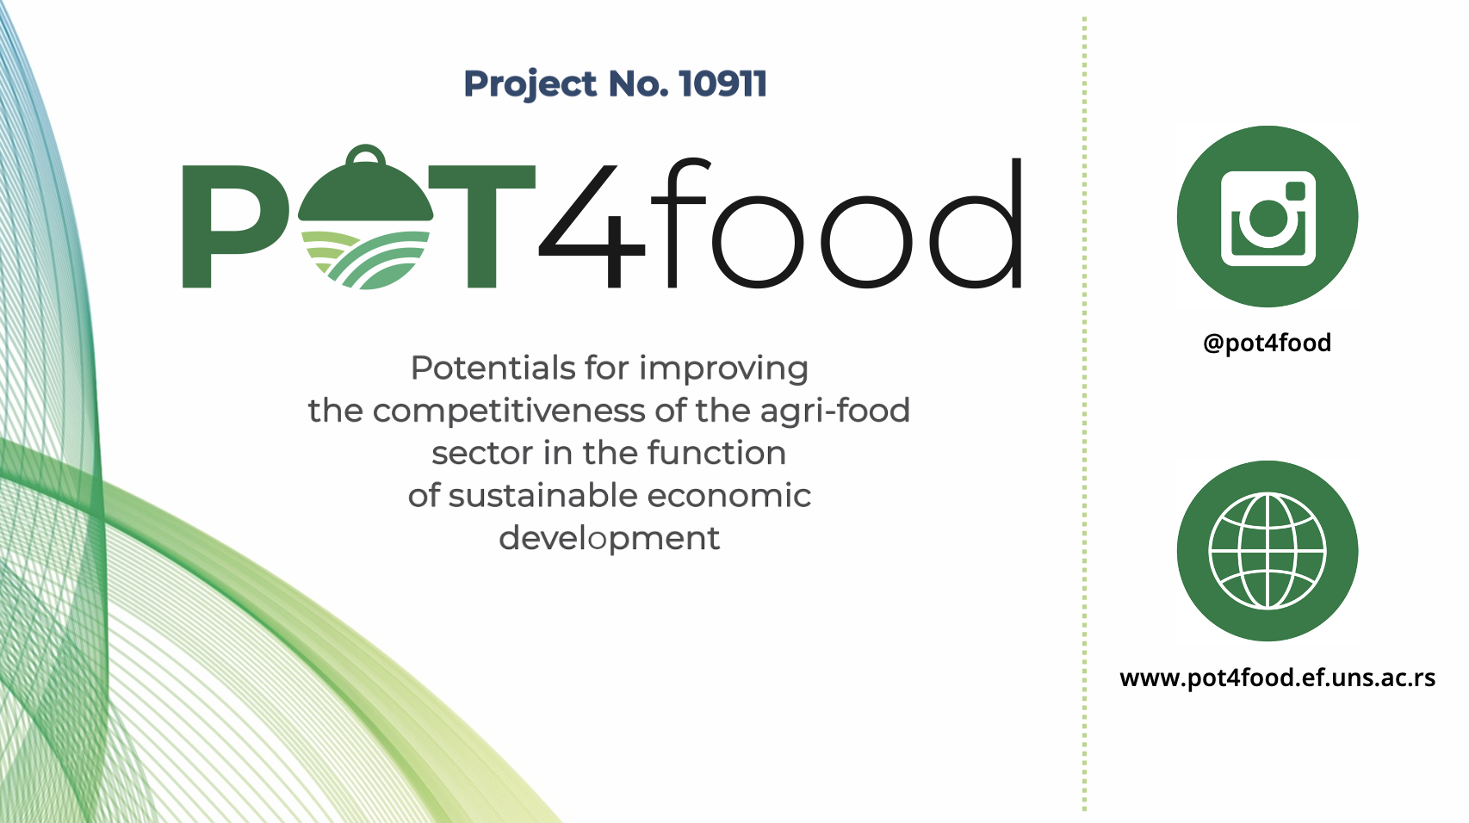
ACKNOWLEDGMENT

Slide 13
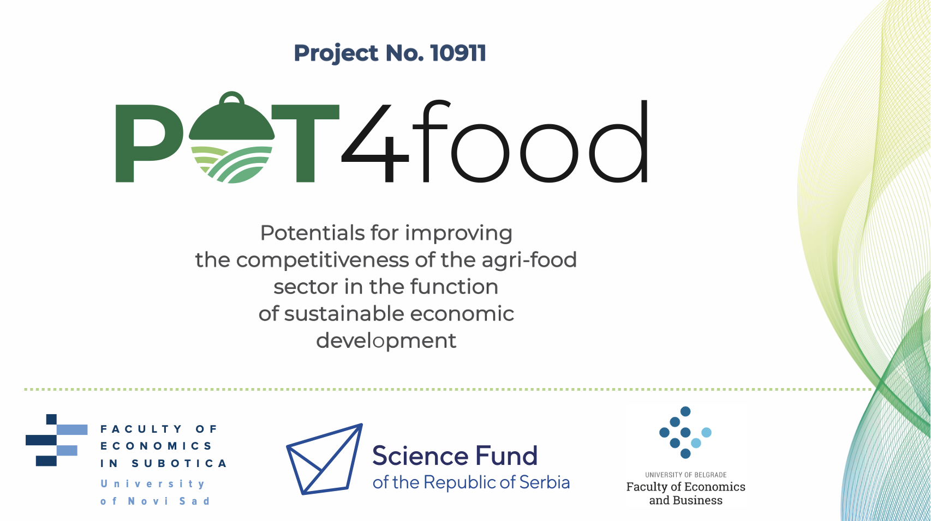
THANK YOU
FOR
YOUR ATTENTION!

Slide 14
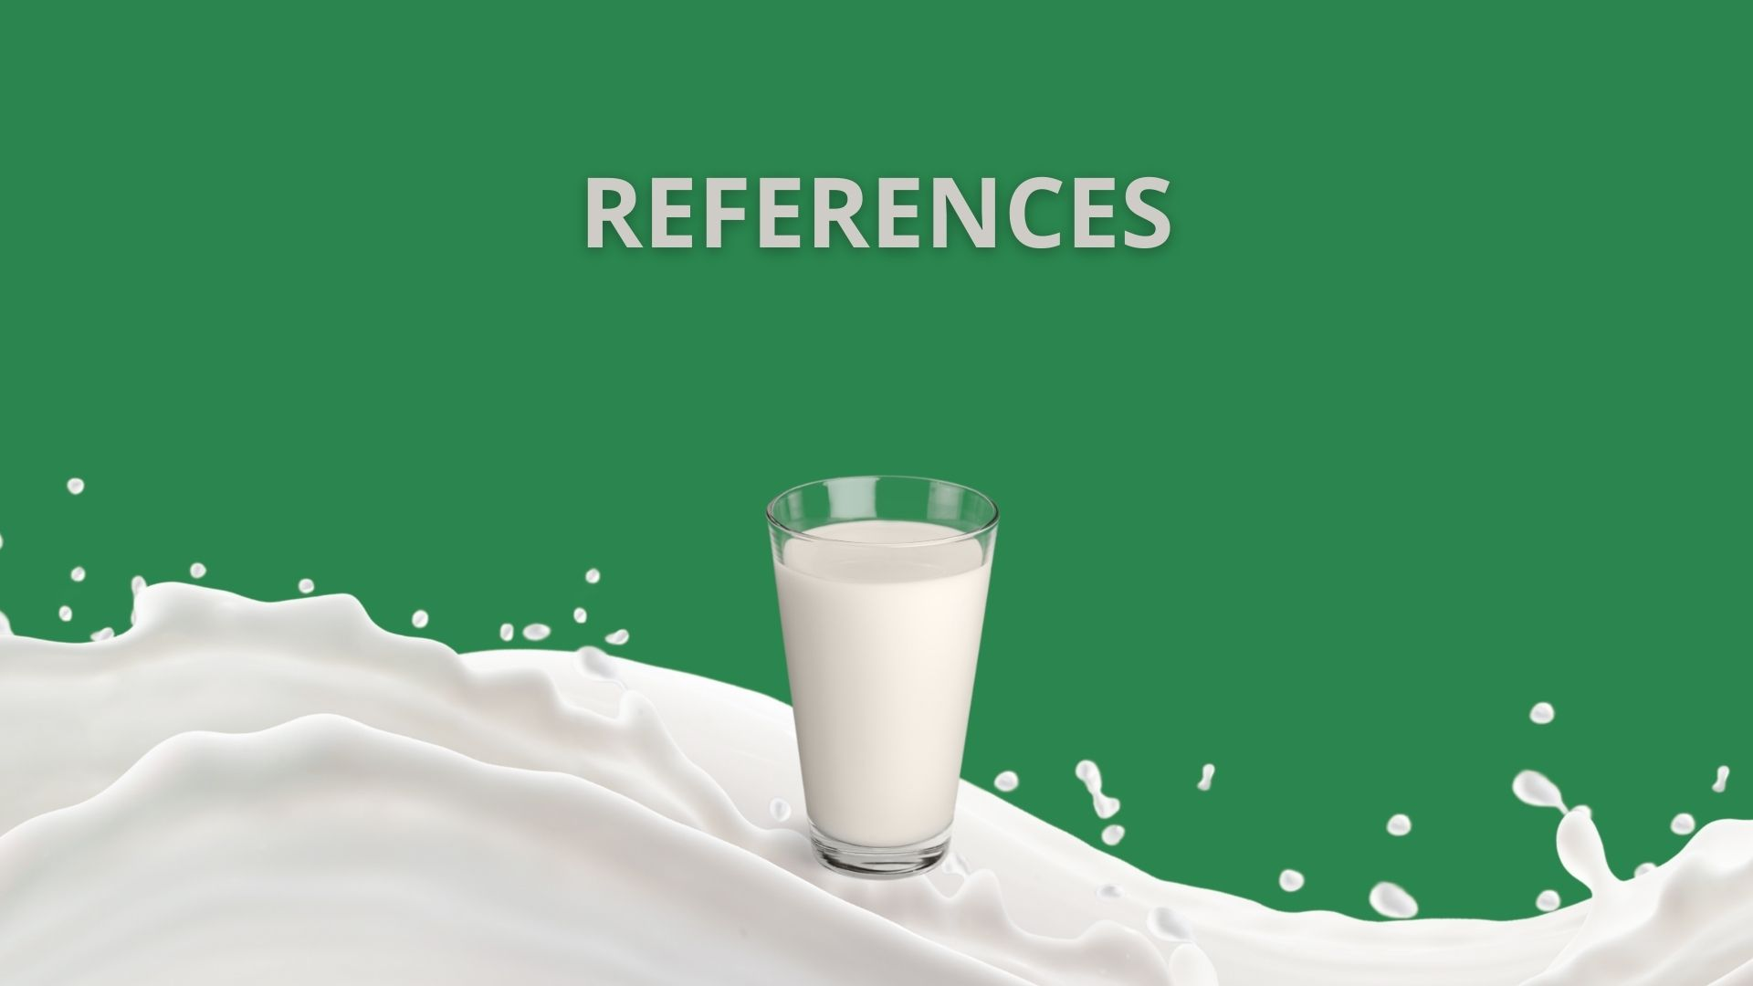

Slide 15
Castro Campos, B., & Qi, X. (2024). A literature review on the drivers and barriers of organic food consumption in China. Agricultural and Food Economics, 12(1), 18. https://doi.org/10.1186/s40100-024-00312-y
Ćendić, J., & Zarić, V. (2019). Motives of buying organic products in the Republic of Serbia.Agroekonomika, 48(82), 71–78.
Dutta-Bergman, M. J. (2004). Primary sources of health information: Comparisons in the domain of health attitudes, health cognitions, and health behaviors. Health communication, 16(3), 273-288. https://doi.org/10.1207/S15327027HC1603_1
Katt, F., & Meixner, O. (2020). A systematic review of drivers influencing consumer willingness to pay for organic food. Trends in Food Science & Technology, 100, 374-388. https://doi.org/10.1016/j.tifs.2020.04.029
Kos, J., Lević, J., Đuragić, O., Kokić, B., & Miladinović, I. (2014). Occurrence and estimation of aflatoxin M1 exposure in milk in Serbia. Food control, 38, 41-46. https://doi.org/10.1016/j.foodcont.2013.09.060
Kovačević, V. (2021). Analysis of current state and limiting factors for the development of organic sector in Serbia. Western Balkan Journal of Agricultural Economics and Rural Development (WBJAERD), 3(1), 23-33. https://doi.org/10.3390/su12083261
Luchs, M. G., Phipps, M., & Hill, T. (2015). Exploring consumer responsibility for sustainable consumption. Journal of Marketing Management, 31(13-14), 1449-1471. https://doi.org/10.1080/0267257X.2015.1061584

Slide 16
Magnusson, M. K., Arvola, A., Hursti, U. K. K., Åberg, L., & Sjödén, P. O. (2001). Attitudes towards organic foods among Swedish consumers. British food journal, 103(3), 209-227. https://doi.org/10.1108/00070700110386755
Rana, J., & Paul, J. (2017). Consumer behavior and purchase intention for organic food: A review and research agenda. Journal of retailing and consumer services, 38, 157-165. https://www.sciencedirect.com/science/article/pii/S0969698917301078#s0100
Smigic, N., Djekic, I., Tomasevic, I., Stanisic, N., Nedeljkovic, A., Lukovic, V., & Miocinovic, J. (2017). Organic and conventional milk – insight on potential differences. British Food Journal, 119(2), 366–376. https://doi.org/10.1108/BFJ-06-2016-0237
Stanković, T., Andjelković, A., & Milovanović, G. (2023). Distribution Channels for Organic Food in the Republic of Serbia. Economic Themes, 61(2), 269–287. https://doi.org/10.2478/ethemes-2023-0014
Vehapi, S., & Dolićanin, E. (2016). CONSUMERS BEHAVIOR ON ORGANIC FOOD: EVIDENCE FROM THE REPUBLIC OF SERBIA. Економика пољопривреде, LXIII(3), Article 3. https://www.cabidigitallibrary.org/doi/pdf/10.5555/20163345548
Vehapi, S., & Mitic, S. (2021). GENERATION Z CONSUMERS' MOTIVES AND BARRIERS TO PURCHASING ORGANIC FOOD PRODUCTS IN SERBIA. Економика пољопривреде, LXVIII(4), Article 4.
Wang, J., Xue, Y., & Liu, T. (2023). Consumer motivation for organic food consumption: Health consciousness or herd mentality. Frontiers in Public Health, 10, 1042535. https://doi.org/10.3389/fpubh.2022.1042535

Slide 17


Slide 18
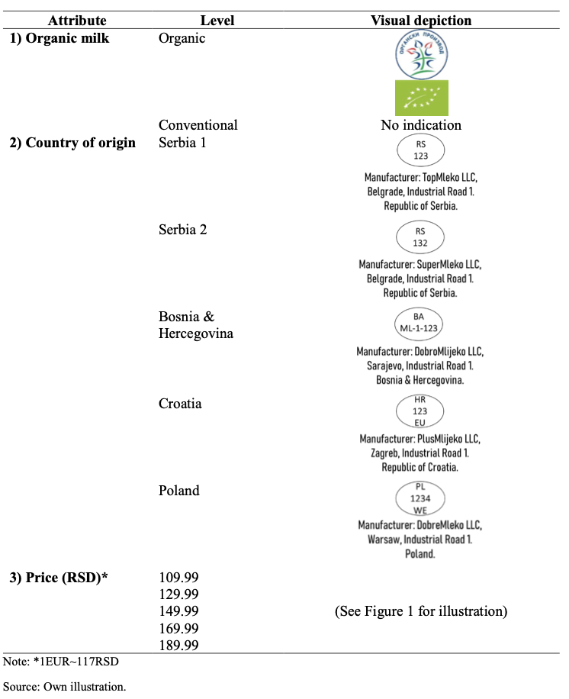
(1) Attributes and levels of milk used in the choice experiment

Slide 19
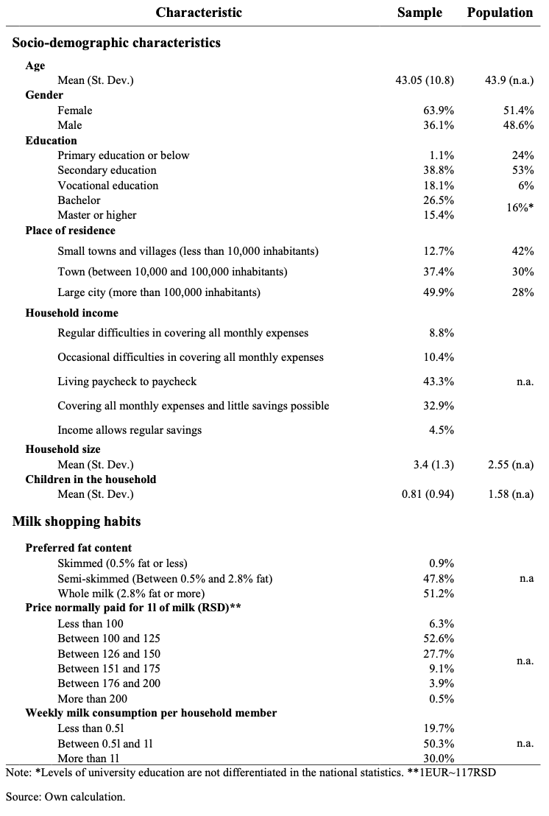
(2) Sample characteristics (N=441)

Slide 20
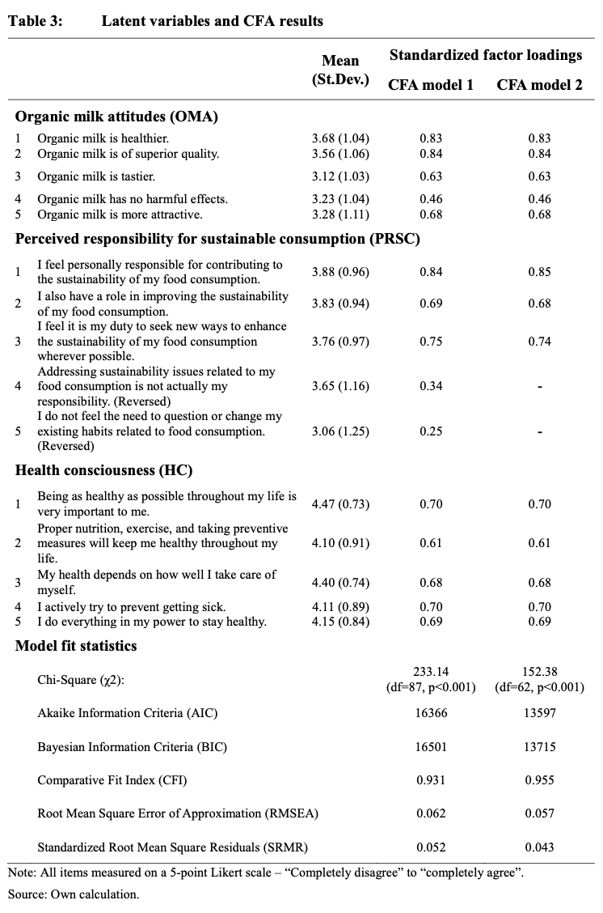
(3) Latent variables and CFA results

Slide 21
(4) RPL model estimates and MWTP

Slide 22
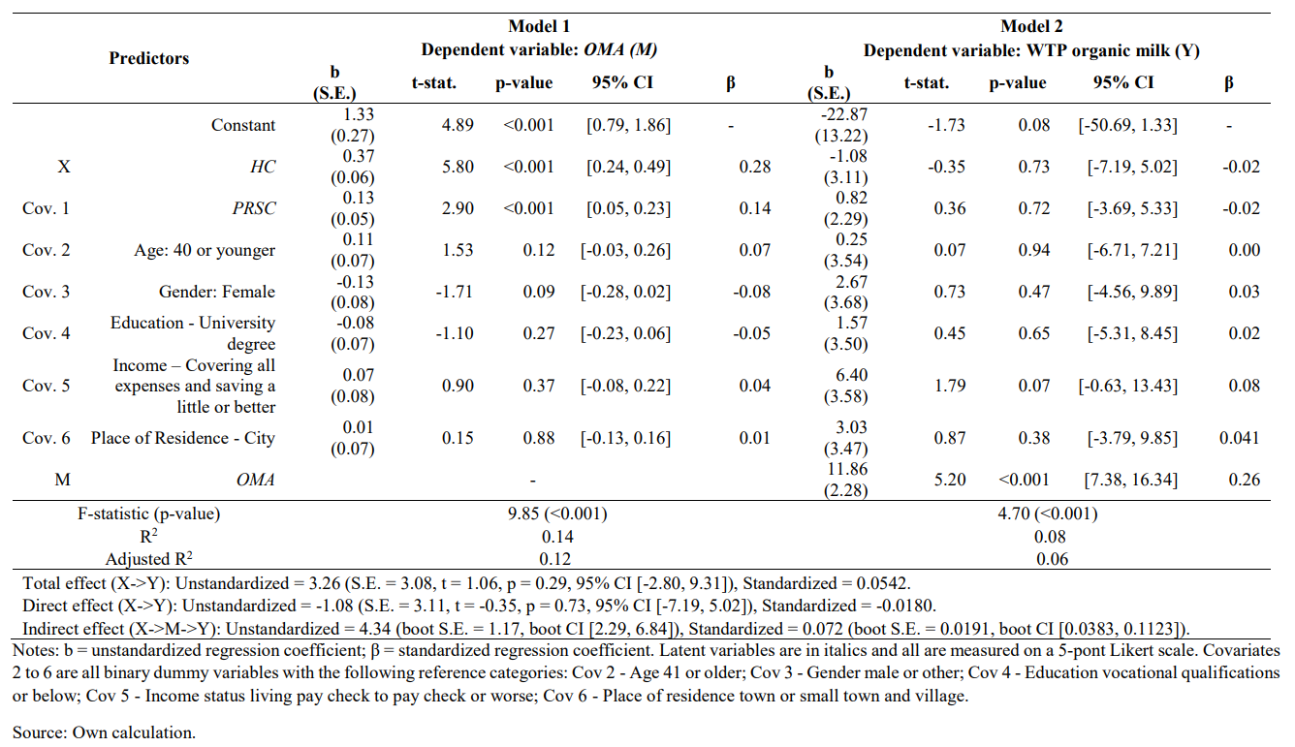
(5) Mediation model results

